Slide 1
PALM VEIN PATTERN AUTHENTICATION SYSTEM
Abhishek Bhowal - 12-1-5-009
Shruti Datta Gupta - 13-1-5-004
Utkarsh Jain - 13-1-5-040
Abu Saleh Fahmid Islam - 13-1-5-066
Muralidhar Nagalla - 13-1-5-071
Anand Kumar - 13-1-5-086
Under the esteemed guidance of
Dr. Shyamapada Mukherjee
Dept. of Computer Science and Engineering

Slide 2
OBJECTIVE
To design a vascular pattern based biometric system which performs two purposes of authentication: verification and identiﬁcation.
Our project consists of an easy to implement device that takes a snapshot of the subject’s veins under a source of infrared radiation at a specific wavelength and uses this unique feature for recognition systems.

Slide 3
KEYWORDS
AUTHENTICATION: Authentication is a process in which the credentials of an individual are compared to that stored in a database of authorized users’ information. Only if the credentials match, the user is granted authorization for access.
BIOMETRICS: Biometrics refers to methods for recognizing individual people based their on unique physical and behavioural traits.
VEIN RECOGNITION: It is a type of biometrics that can be used to identify individuals based on the vascular patterns in their body. It can be used for PC login, bank ATM identiﬁcation etc.

Slide 4
LITERATURE REVIEW

Slide 5
NEED FOR BIOMETRICS
Easy but risky access to individual information.
Passwords, personal identiﬁcation numbers (PIN) or identiﬁcation cards are used for personal identiﬁcation.
Cards can be stolen, and passwords and numbers can be guessed or forgotten
Biometric authentication technology identiﬁes people by their unique biological information, their physical and behavioural traits, which cannot be stolen forgotten, but is inherent in every individual.

Slide 6
WHY PALM VEIN BIOMETRICS?
Durable, unique and permanent pattern
Anti-counterfeit: Vascular patterns are present underneath the skin making it almost impossible to forge or copy.
Active liveliness: Vein information disappears with biological tissues losing liveliness.
Traceless technology: The biometric parameter is hidden from general view.

Slide 7
SL NO. | TITLE OF PAPER | AUTHORS | YEAR OF PUBLICATION | OVERVIEW
1 | Palm Vein Pattern Technology | Fujitsu | May 2007 | One of the first successful implementation and commercialization of Palm vein Pattern Recognition Technology
2 | Palm Vein Authentication System: A Review | Ishani Sarkar, Farkhod Alisherov, Tai-hoon Kim, and Debnath Bhattacharyya | March 2010 | Another Implementation of Palm vein pattern technology.
3 | Palm vein authentication | Nirmal T M, Mathew Francis | June 2014 | Palm vein authentication technology implementation.
4 | Biometric Technology Based on Hand Vein | Sarah Benziane and Abdelkader Benyettou | December 2013 | Authentication system using palm vein pattern recognition
5 | ORB: an efficient alternative to SIFT or SURF | Ethan Rublee, Vincent Rabaud, Kurt Konolige, Gary Bradski | June 2011 | An open source alternative to SIFT and SURF. Use Oriented FAST and Rotated BRIEF algorithms.

Slide 8
SL NO. | TITLE OF PAPER | AUTHORS | YEAR OF PUBLICATION | OVERVIEW
6 | Threshold and binarization for document image analysis using Otsu’s Algorithm | Dr. Neeraj Bhargava, Anchal kumawat, Dr. Ritu Bhargava | November 2014 | OTSU’s binarization technique and its advantages over other binarization techniques.
7 | Biometrics Authentication Using Raspberry Pi | L.Arun Kumar, A.Arun Raja | May 2015 | Palm vein authentication using raspberry pi on the hardware side.
8 | High Security using Palm Vein Recognition Technology | Lakshmi Sudha.K, Neha Bhanushaliv, Pooja Nikam | June 2015 | Palm vein authentication technology implementation.
9 | Finger print matching algorithm using ratios of relational distances | Abhinandan Chandrakesan and Bhavani Thuraisingham | May 2006 | Fingerprint authentication technology implementation.

Slide 9
SL NO. | TITLE OF PAPER | AUTHORS | YEAR OF PUBLICATION | OVERVIEW
10 | Contrast Limited Adaptive Histogram Equalization for Qualitative Enhancement of Myocardial Perfusion Images | Neethu M.Sasi, V.K.Jayasree | August 2013 | Implementation of CLAHE histogram equalization Technique.
11 | Corner Detection using FAST | Edward Rosten and Tom Drummond | Sept. 2006 | FAST corner detection algorithm which detects corner using accelerated segment test.
12 | Binary Robust Independent Elementary Features | Michael, Calonder, Vincent Lepetit, Christoph Strecha, and Pascal Fua | May 2010 | The algorithm is used to give descriptors for the extracted features in the form of a binary string. The string can then be used to match various keypoints.
13 | Basics of Gaussian filtering | University of Aukland, New Zealand | April 2008 | Gaussian blur is used for noise cancellation.

Slide 10
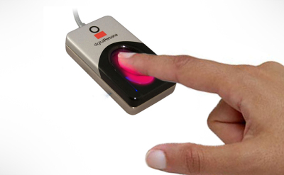

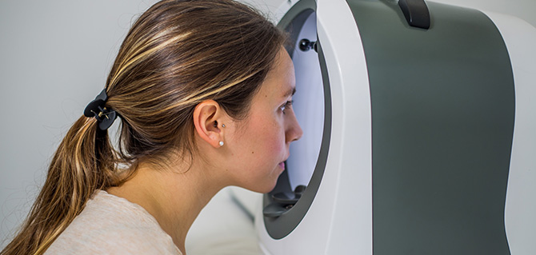
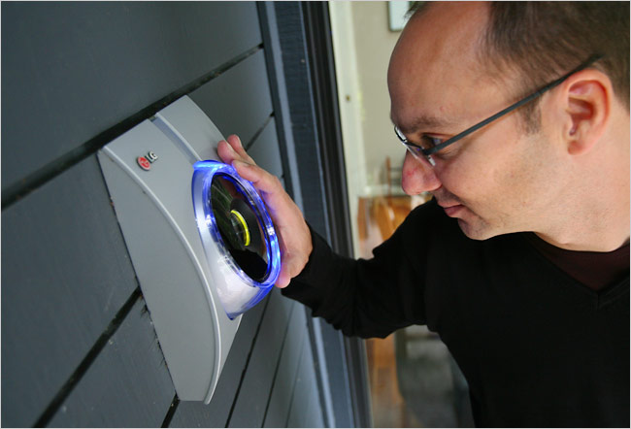
EXISTING BIOMETRIC TECHNOLOGIES AND COMPARISONS
Fingerprint scanner
Face recognition
Retina scanner
Voice recognition

Slide 11
PALM VEIN PRINCIPLES
Deoxidized haemoglobin absorbs light at a wavelength of about 760 nm in the near-infrared region.
When infrared ray image is captured, the deoxidized haemoglobin in the palm veins absorbs this light, and appears as a series of black lines.
Based on this feature, the region used for authentication is photographed with near-infrared light, and the vein pattern is extracted by image processing and registered.

Slide 12
ALGORITHMS USED

Slide 13
KEYPOINTS AND FEATURE EXTRACTION
A key-point is a point in the image which in general has a clear, preferably mathematically well-founded definition and a well-defined position in image space.
Feature extraction is a type of dimensionality reduction that efficiently represents interesting parts of an image as a compact feature vector.
Image descriptors are used to compare key-points between two different images.
This approach is useful when image sizes are large and a reduced feature representation is required to quickly complete tasks such as image matching and retrieval.

Slide 14
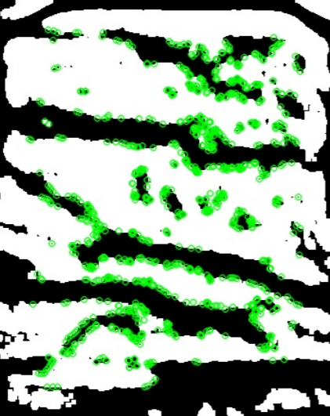
Illustrative figure showing valuable points(key-points) in vein-extracted image

Slide 15
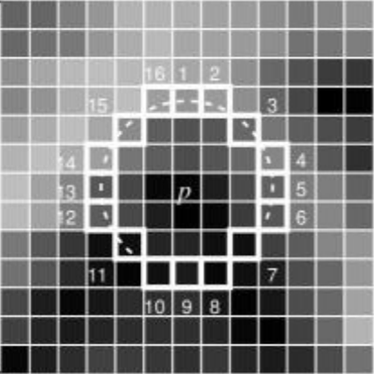
ORB: Oriented FAST and Rotated BRIEF
Features from Accelerated Segment Test (FAST) is used for corner detection in images.
Consider a circle of 16 pixels around the pixel under testing. Pixel ρ is a corner if there exists a set of ’n’ contiguous pixels in the circle which are all brighter than ß+γ, or all darker than ß-γ. Where ß is the intensity of ρ, γ is n appropriate threshold.

Slide 16
ORB: Oriented FAST and Rotated BRIEF
ORB uses BRIEF(Binary Robust Independent Elementary Features) descriptors.
A smoothened image patch is taken and a set of n (x,y) location pairs is selected in a unique way. Then some pixel intensity comparisons are done on these location pairs.
For eg, let first location pairs be p and q. If the intensity of p is less than that of q, then its result is 1, else it is 0. This is applied for all the n location pairs to get a n-dimensional bit-string.

Slide 17
ORB: Oriented FAST and Rotated BRIEF
Using FAST and rotated BRIEF, ORB computes the intensity weighted centroid of the patch with located corner (by FAST) at center.
The direction of the vector from this corner point to centroid gives the orientation.
To improve the rotation invariance, moments are computed which should be in a circular region of radius r, where r is the size of the patch.

Slide 18
OTSU’s BINARIZATION
It calculates a threshold value from image histogram for a bimodal image.
The algorithm assumes that the image contains two classes of pixels following bi-modal histogram: foreground pixels and background pixels.
The optimum threshold separating the two classes is calculated so that their combined spread (intra-class variance) is minimal, or equivalently (because the sum of pairwise squared distances is constant), so that their inter-class variance is maximal.

Slide 19
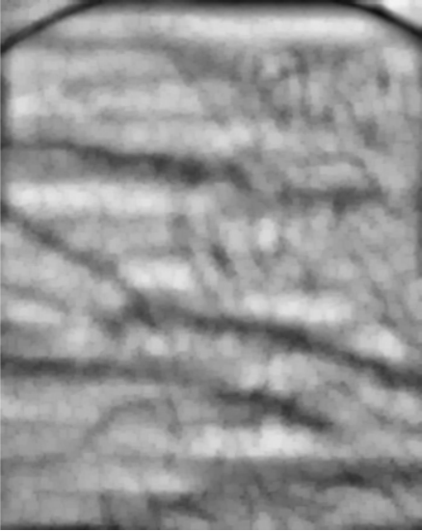

Extracted vein image before thresholding
After OTSU thresholding

Slide 20
CLAHE (Contrast Adaptive Limited Histogram Equalization)
The image is divided into small blocks called ”tiles”.
Each of these tiles are histogram equalized. So in a small area, histogram would confine to a small region (unless there is noise). If noise is there, it will be amplified.
To avoid this, contrast limiting is applied. If any histogram bin is above the specified contrast limit, those pixels are clipped and distributed uniformly to other bins before applying histogram equalization.
After equalization, to remove artefacts in tile borders, bilinear interpolation is applied.

Slide 21

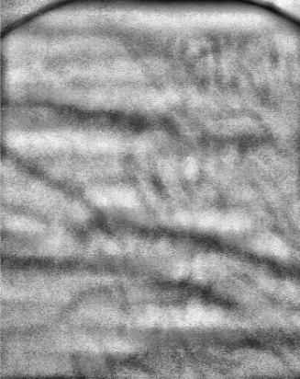
Extracted vein image showing
Region of Interest
Histogram equalisation
after using CLAHE

Slide 22
GAUSSIAN BLUR
Gaussian blur or Gaussian filter is applied in image processing as a smoothening filter.
It is the result of blurring an image by a Gaussian function typically to reduce image noise and reduce detail.

Slide 23
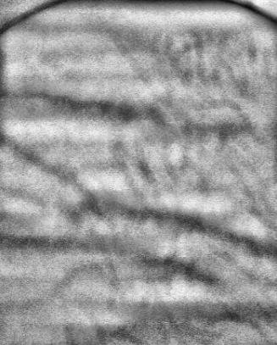
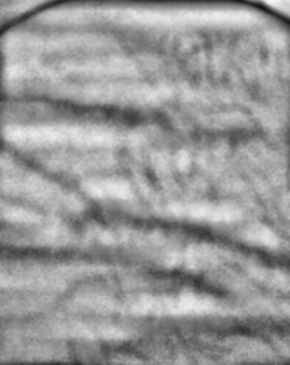
Extracted vein image
before Gaussian blur
Extracted vein image
after Gaussian blur

Slide 24
KNN MATCHER
KNN matcher is a subset of brute force matcher which takes the descriptor of one feature in first set and matches it with all other features in second set using some distance calculation and the closest one is returned.
For brute force matcher, first we have to create the matcher object. It takes two optional parameters:
Normal type- It specifies the distance measurement to be used. For binary string based descriptors like BRIEF, hamming distance is be used.
A Boolean variable- It is false by default. If it is true, matcher returns only those matches with value (i,j) such that i-th descriptor in set A has j-th descriptor in set B as the best match and vice-versa.
Once the optional parameters are created, k best matches are returned where k is specified by the user.

Slide 25
SYSTEM DESIGN

Slide 26
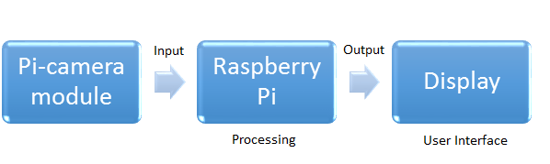
HARDWARE DESIGN

Slide 27
RASPBERRY PI MODULE
It is a single board computer which works as a central module of the whole embedded image capturing and processing system of our system.
An authentication system using raspberry pi is fast enough to run the image scanning algorithms and the data stream can flow smoothly between the camera and the raspberry pi board.
Its main parts include:
Main Processing chip (Broadcom BCM2837 SOC)
Memory : 2GB 21 5. SYSTEM DESIGN
Internal Storage : 32GB • OS : Debian 8 Jessie
Power supply, HDMI out, Ethernet port, USB Ports and other.

Slide 28
RASPBERRY PI CAMERA MODULE
The V2 Pi NoIR has a Sony IMX219 8MP Sensor
It can connect to the Raspberry Pi directly with Camera Serial Interface(CSI).
The Pi Cam is used to capture the infrared image of the palm vein pattern of the individual, which can then be processed further.

Slide 29
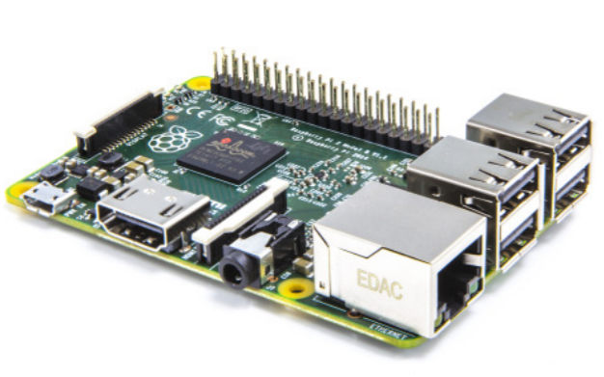
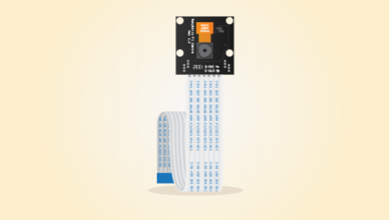
Raspberry Pi module
Pi Camera module

Slide 30
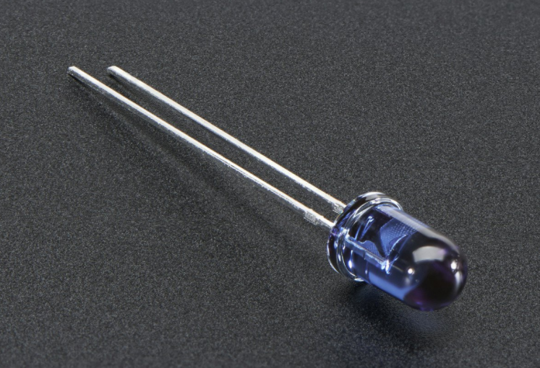
IR LEDs
The IR LEDs that are used are of 180mW power output and the range of the radiation is between 750-890nm.

Slide 31
SOFTWARE DESIGN

Slide 32
USER INTERFACE
It is used for client side interaction (console based on the raspberry pi)
The user is first prompted to either add a new data, login to the system, delete a record or exit.
For adding a new record/login, the user has to enter their name, roll number and get their vein pattern scanned, which is then stored in database and used for authentication.
The roll number of user is used as an index in the database

Slide 33
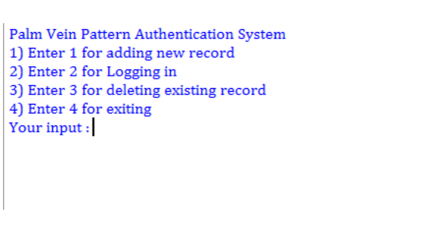

Slide 34
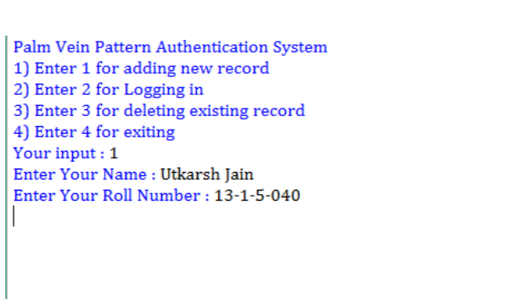

Slide 35
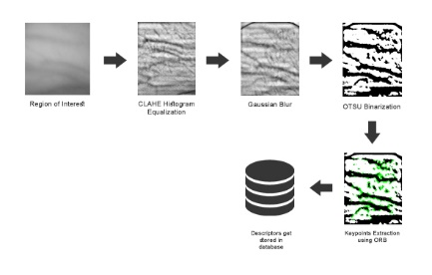
IMAGE PROCESSING
The algorithms used are coded in python for matching and storing the scanned image. We have used OpenCV which is an open source computer vision library.

Slide 36
USER REPOSITORY
It stores the personal details for the user and descriptors for the palm vein image.
MongoDB: An open-source document database and leading NoSQL database.
PyMongo: A python distribution containing tools for working with MongoDB, and is the recommended way to work with MongoDB from Python.
Data captured by the camera
Image enhancement
Feature extraction
Descriptors
Salt
To DataBase

Slide 37
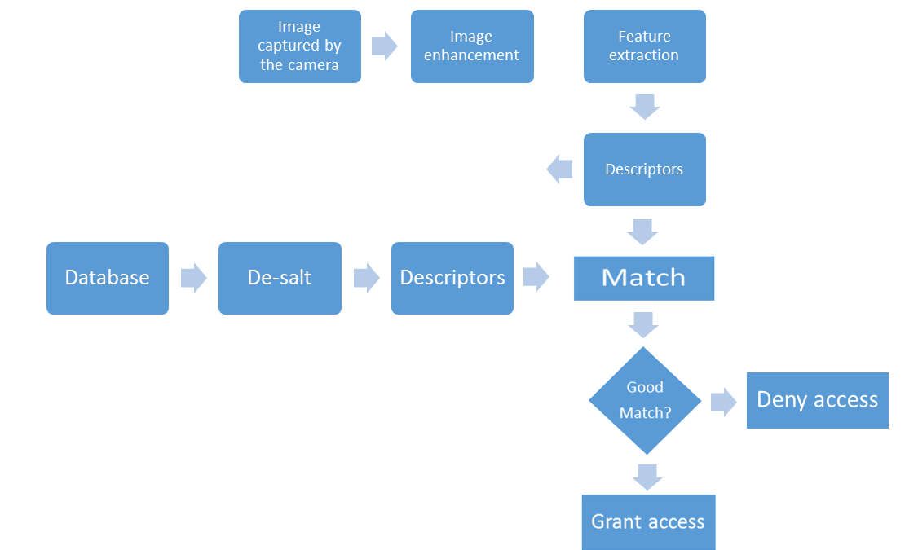
Flowchart showing all the functional modules

Slide 38
RESULTS

Slide 39
SL NO | RATIO | THRESHOLD | FAR (%) | FRR (%)
1 | 0.5 | 75 | 0 | 100
2 | 0.6 | 75 | 0 | 100
3 | 0.65 | 75 | 0 | 100
4 | 0.70 | 75 | 0 | 100
5 | 0.75 | 75 | 0 | 100
6 | 0.80 | 75 | 0 | 20
7 | 0.80 | 100 | 0 | 70
8 | 0.85 | 100 | 100 | 0
9 | 0.85 | 150 | 40 | 20
FRR and FAR calculation using suitable threshold

Slide 40
CONCLUSION AND FUTURE WORKS
We have implemented an Palm Vein Pattern Authentication System using dorsal vein imaging using the hardware described above and basic console based system.
As per the tests conducted, we arrived at a FAR of 0% and FRR 20%.
For future works, we plan to implement a GUI based palm vein pattern authentication system which can be used for student attendance in our college.
We also plan to conduct more extensive surveys and necessary modifications in our algorithms to achieve better results.

Slide 41
THANK YOU

